Slide 1

HR
Analytics
Suite
Presented by –
Himanshu Pathak

Slide 2

Introduction
HR Analytics Suite: Unveiling Workforce Insights 👥📊
Objective
To Build a Tableau HR dashboard for key HR metrics and employee details

Slide 3
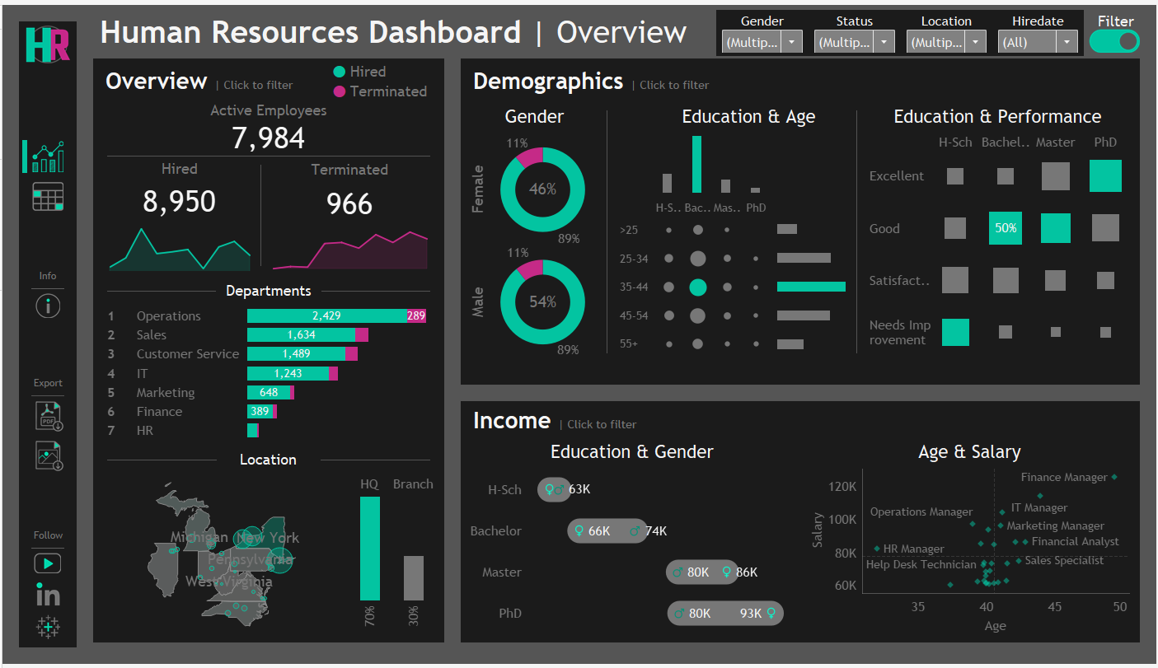

Slide 4
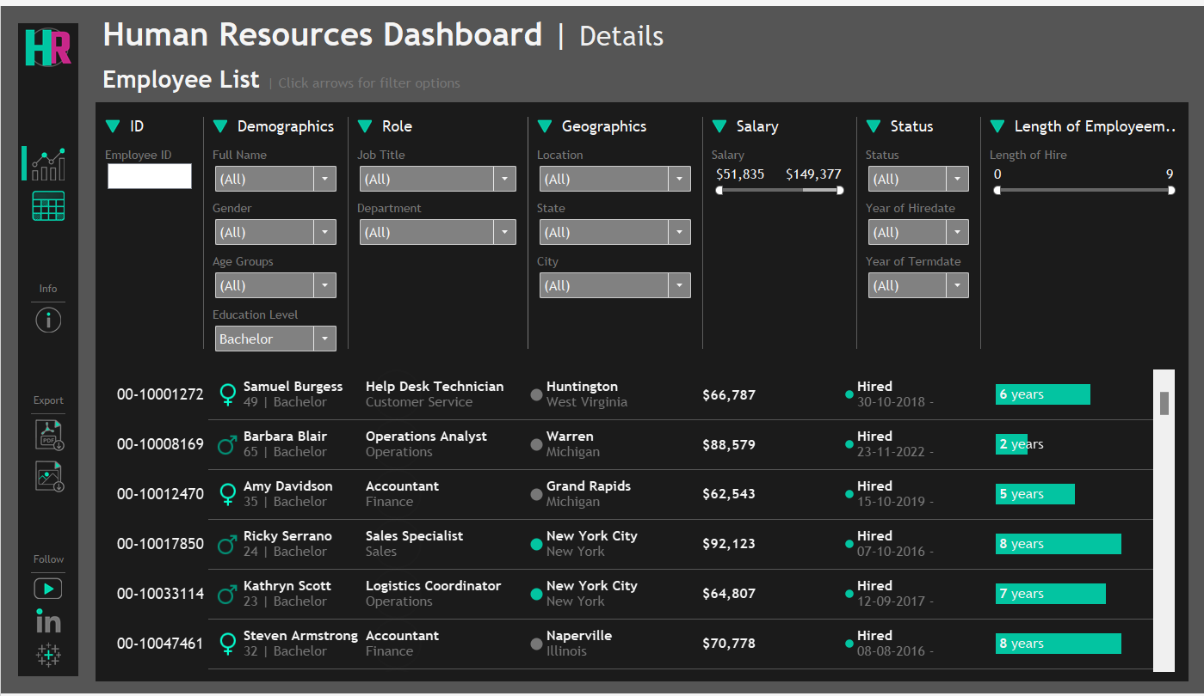

Slide 5

Interactive
Features and Functionalities
Custom Filters: Easily filter by department, job title, gender, age group, education level, and salary range.
Drill-Downs: Click on data points to view detailed employee records.
Hover Tooltips: Hover for additional information and insights.
Real-Time Charts: Charts update
Export Data: Export data and visualizations for easy reporting.
Easy Navigation: Seamlessly move between different dashboard sections.

Slide 6




Thank You
I appreciate your time and interest in my HR Analytics Suite project.
Your feedback and questions are welcome!
Stay engaged and keep exploring!

